Slide 1
COVID-19
THE ECONOMY
THE P&C INDUSTRY
AND TECH SPENDING
Time is of the essence
March 31, 2020
Donald Light
dlight@celent.com

Slide 2

STATEMENT OF SCOPE
This is a webinar about the potential impact of COVID-19 on the economy, the Property & Casualty insurance industry, and technology spending within that industry
The scope of the webinar is focused on the United States
Viewers should see no implications nor draw any conclusions from this webinar regarding any other geography or other insurance sector
I am a technology analyst covering the P&C industry in North America. I am not an economist, and I am certainly not an epidemiologist.
However, understanding the outlook for technology spending by P&C insurers, requires a point of view on COVID-19’s impact on the economy, and the impact of changes in the economy on the P&C industry.
See Appendix for additional resources from the Oliver Wyman Group

Slide 3
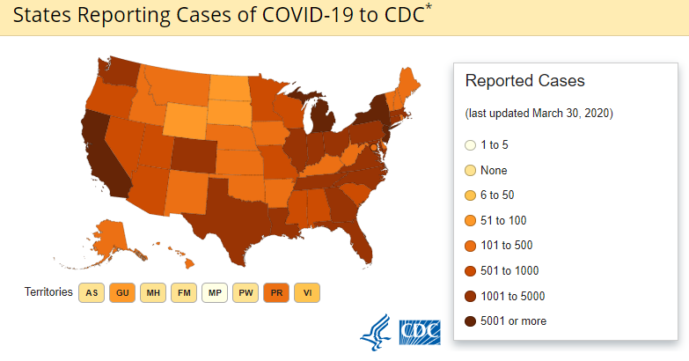
covid-19 IN THE UNITED STATES
As of March 30, the US government’s Center for Disease Control reported
Total cases
140,904
Total deaths
2,405
All states and other jurisdictions reporting cases
Source: CDC March 26, 2020 update https://www.cdc.gov/coronavirus/2019-ncov/cases-updates/cases-in-us.html

Slide 4
COVID-19 HAS CREATED A CHAIN WITH THREE links
IT’S ALL ABOUT IMPACT
Technology Spending
The Economy
03
01
02
P&C Industry Financials

Slide 5




First link: impact on the economy
The Economy
01
02
03
Economic projections
Travel and leisure sectors
Auto and homes
Other sectors
Q2 reduction in GNP
  Goldman Sachs -24%
  JP Morgan -14%
Unemployment
  During the week of March 15, 3.28 million workers applied for unemployment insurance – 5× the previous high
  Several April projections of unemployment over 10% and 18 million people out of work
Airlines face potential complete US shutdown
Hotels: Possible 4 million jobs lost
Travel and Leisure industry had made 9,000 job cut announcements as of March 24
New auto sales in 2020 projected to drop from 17 million to under 14 million
The National Association of Homebuilders reports a significant adverse effect on their business
There are scattered reports on commercial construction shutdowns
Over 38,000 retail and restaurant locations have closed
  Some “indefinitely” such as Apple Stores, Ann Taylor and Lane Bryant
  Others for 2 to 3 weeks
In the US, decisions on shut-downs are made by state and local governments, not centrally by the federal government

Slide 6
SECOND LINK: Impact on P&C INDUSTRY financials
The Economy
01
02
03
 | Premiums |  | Fewer new cars, new homes, new commercial buildings, new workers More missed premium payments, more cancelled policies
+ | Expenses |  | Insurers are typically reluctant to reduce head counts
- | Losses |  | Fewer motor vehicle accidents, lower homeowners claims (WFH), less commercial activity leading to fewer general liability claims. Balanced by possible spike in cyber, D&O, Medical Prof. Liability, WC claims. Enforcement of policy exclusions and minimal civil unrest also open to question.
+ | Capital Gains |  | Equity prices have fallen rapidly, S&P 500 has declined ~28% (Feb 19 2020 to March 26 2020) Bond yields have dropped dramatically (10 year Treasury yield declined from 1.566% to 0.862% (Feb 19 2020 to March 26 2020) (possible capital gains if some bonds sold)
+ | Dividends |  | Likely unchanged, may see some reductions from cash-strapped firms
+ | Interest Income |  | Longer term low interest on new issues and some danger of defaults
= | Profit |  | Assumes premium declines, losses at best stay even

Slide 7
DISTRIBUTION OF P&C INSURER ASSETS IS WEIGHTED HEAVILY TOWARDS BONDS
01
02
03
Source: Insurance Information Institute, 2020 Insurance Fact Book

Slide 8
Third link: impact on P&C technology spending (1/2)
The Economy
01
02
03
IT Budgets as Percentage of DPW for Large, Midsize and Small North American Insurers
High, Average, and Low Percentages for Each Segment
Source: Celent Report, P&C Insurer CIO Priorities and Pressures, North American 2020

Slide 9
Third link: impact on P&C technology spending (2/2)
The Economy
01
02
03
Outlook for CY 2020 | Types of Initiatives
 | Underway, large and some midsize projects, e.g. Core system modernization Data and Analytics, especially using AI/ML Cloud Migration Customer Experience Automation Security/Compliance
 | Underway, small and some midsize projects, e.g., Back office Point Solutions
 | New initiatives, especially large and multi-year, e.g., Core system modernization Data and Analytics, especially using AI/ML Cloud Migration Anything else without compelling ROI or value propositions in a 12 to 18 month timeframe

Slide 10

Time is of the essence: Why q2 is critical
IF | AND IF | THEN | HOWEVER
… the COVID-19 cases and the resulting economic shutdowns largely abate during Q2, several US economic forecasts show moderately positive growth in Q3 and Q4 | … P&C technology spending does follow the general financial fortunes of the P&C industry | … The outlook for technology spending looks reasonably positive for 2020 Q3 and Q4, and for 2021 | … other outcomes are certainly possible

Slide 11
APPENDIX a
Additional resources from the Oliver Wyman Group and Celent
Oliver Wyman COVID-19 Hub: Responding to Coronavirus
https://www.oliverwyman.com/our-expertise/hubs/coronavirus.html
How European Insurers Can Manage the Impact of COVID-19
https://www.oliverwyman.com/our-expertise/insights/2020/mar/covid-19-european-insurance.html
Cyber Risk Grows as COVID-19 Spreads
https://www.oliverwymanforum.com/cyber-risk/2020/mar/cyber-risk-grows-as-covid-19-spreads.html
How Insurance Risk Functions Should Respond to COVID-19
https://www.oliverwyman.com/our-expertise/insights/2020/mar/covid-19--perspectives-for-insurance-risk‑functions.html
Benchmarking COVID-19 – An Actuarial Perspective
https://www.oliverwyman.com/content/dam/oliverwyman/v2/publications/2020/March/benchmarking-covid19-an-actuarial-perspective.pdf
COVID-19-Three Scenarios for Insurers (Celent Report)
https://www.celent.com/insights/755060517

Slide 12

Questions
&
Comments
Contact
Donald Light
dlight@celent.com

